Slide 1

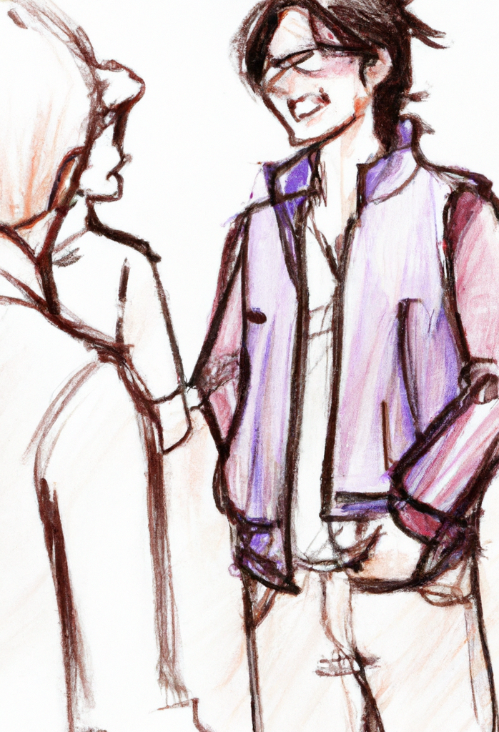
How to win
Conferences
Notes:
Abstract:
Did you know that science has been conducted for over a decade on how to have a very lucky life?
Would you like to have a lucky conference?
Not only will I share the research with you, but I will also give practical tips on how you can get the most out of this conference.
Including dispelling some very popular but counter-productive myths.
Let's look at the 4 Principles of being lucky (scientifically speaking) and tips for each one.
Use them all and watch how an ordinary conference becomes extraordinary.
Learning outcomes;
How lucky you are in the 4 categories of opportunity, intuition, Resiliency and expectations
How to get the most out of conferences by:
* Meeting new people
* at lunch
* by standing in a way to invite people
* by staying in touch
* how to get the best experience with new people
* Sessions
* How to find your unknown unknowns
* How to find the right session for you each hour
How to judge a conference
Given at
Amplify

Slide 2

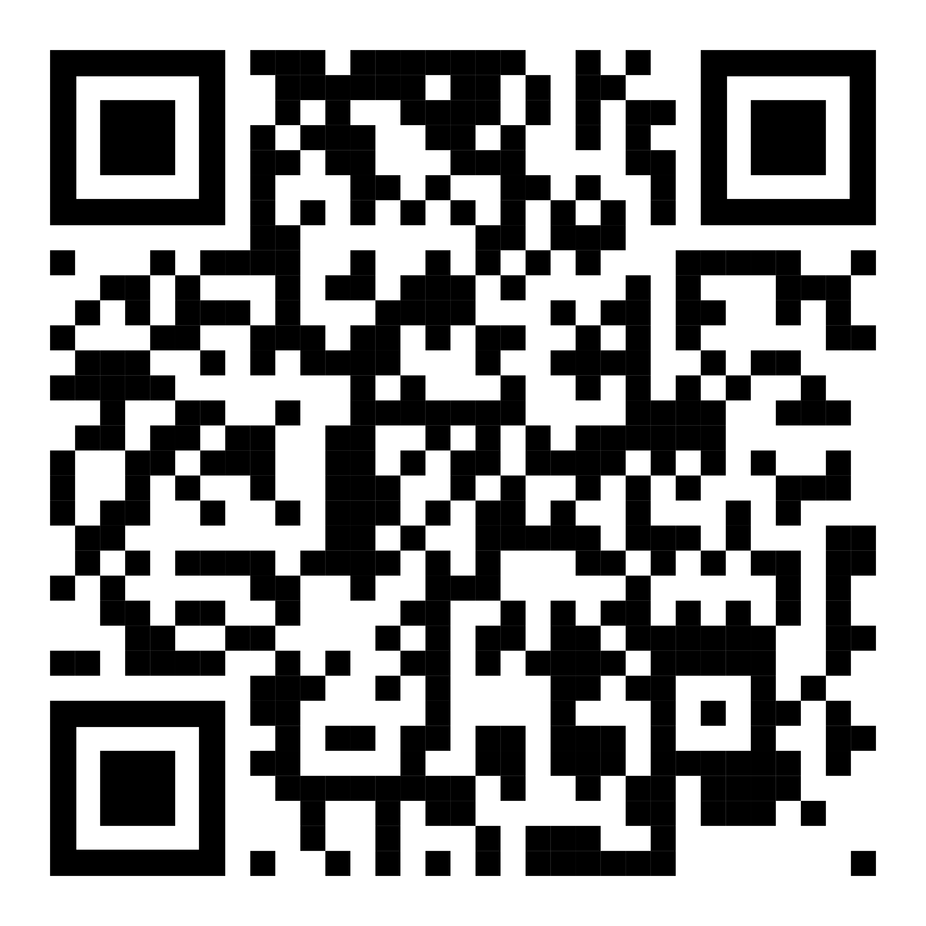
https://github.com/isidore/Talks/blob/master/Conferences.md

Slide 3
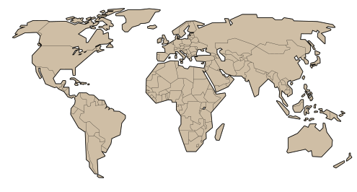

20-30 conferences / year
since 2009

Slide 4

Tips for a better conference
…and maybe a better life

Slide 5


1 / 12
-2
0
+2
I tend to chat to strangers
For example, when in line at a supermarket or bank.

Slide 6
2 / 12
-2
0
+2
I don’t tend to
worry or feel anxious

Slide 7
3 / 12
-2
0
+2
I am open to new experiences
For example, trying new types of food or drinks.

Slide 8
4 / 12
-2
0
+2
I trust my gut & my hunches
and listen to them

Slide 9
5 / 12
-2
0
+2
I have tried some techniques to
boost my intuition
such as meditation or just going to a quiet place

Slide 10
6 / 12
-2
0
+2
I expect good things
to happen to me

Slide 11
7 / 12
-2
0
+2
I tend to try to get what
I want from life
even if the chances of success seem slim

Slide 12
8 / 12
-2
0
+2
I expect most of the people that I meet to be
pleasant, friendly
and helpful

Slide 13
9 / 12
-2
0
+2
I tend to look on
the bright side
of whatever happens to me

Slide 14
10 / 12
-2
0
+2
I believe that even
negative events
will work out well for me
in the long run.

Slide 15
11 / 12
-2
0
+2
I don't tend to
dwell on the things that haven't worked out well for me
in the past

Slide 16
12 / 12
-2
0
+2
I try to
learn from the mistakes
that I have made in the past

Slide 17


The science of luck
Richard Wiseman

Slide 18

👍
Playing the Lottery
👍
$
$
Lucky
Unlucky

Slide 19
chat to strangers
worry or feel anxious
new experiences
Lucky Principle 1 of 4 :
Opportunity

Slide 20

“Wendy is especially fortunate when it comes to winning competitions.
On average, she wins about 3 prizes a week,
including large cash prizes and several major vacations abroad.”
Lucky Principle 1 of 4 :
Opportunity

Slide 21
“Whenever he went to a party, he tended to talk to the same people. To help disrupt this routine, and make life more fun, he thinks of a color before he arrives at the party and speaks only to people wearing that color of clothing!”
Lucky Principle 1 of 4 :
Opportunity

Slide 22



See unexpected opportunities

Slide 23

How to Get the Most Out of a Conference
…Be clear about your goals and desired outcomes…

Slide 24
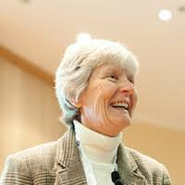
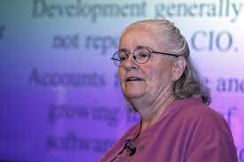


Linda Rising
Mary Poppendieck

Slide 25

Eat Lunch with someone new

Slide 26

What does your subconscious know?
gut & hunches boost my intuition
expect good things
Lucky Principle 2 of 4 :
Intuition

Slide 27
Make a decision, then stop
Engineering Management 101
Kate
Removing Duplication
Llewellyn
Reading Code
Emily
Into to Accessibility
Level Access
Lucky Principle 2 of 4 :
Intuition
Salesforce & Netsuite
Hands on Production Training
Kirei / Audrey

Slide 28
Finding the right talk.
Lucky Principle 2 of 4 :
Intuition
The law of mobility
(The law of two feet)

Slide 29

Self fulfilling prophecies
I try to get what I want
pleasant, friendly and helpful
the bright side
Lucky Principle 3 of 4 :
Expectations

Slide 30
Interviews:
👍
Lucky Principle 3 of 4 :
Expectations
👍
$
$
Lucky
Unlucky

Slide 31



Slide 32

We will see…
negative events will work out
don’t dwell on the past
learn from the mistakes
Lucky Principle 4 of 4 :
Resiliency

Slide 33

What does 10x Look Like?

Slide 34
Gross: $100,000 Gross: $145,000
Overhead: $95,000
(5K Profit)
(50K Profit)
45%

Slide 35
Loan: $100,000 @ 10% interest $839 / month
$2124 / month
(50 years)
(5 years)
2.53x

Slide 36
Loan: $100,000 @ 100% interest $8,333 / month
$8,402 / month
(50 years)
(5 years)
0.8%

Slide 37
My Experience With Mob Programming
(after 1 week)
10x productivity NO
Higher quality YES
Better test coverage YES
Idiomatic code YES
Best practices YES
Minimized bugs YES
Fewer mistakes YES
Better Testability YES
http://engineering.appfolio.com/appfolio-engineering/2014/03/17/my-experience-with-mob-programming

Slide 38
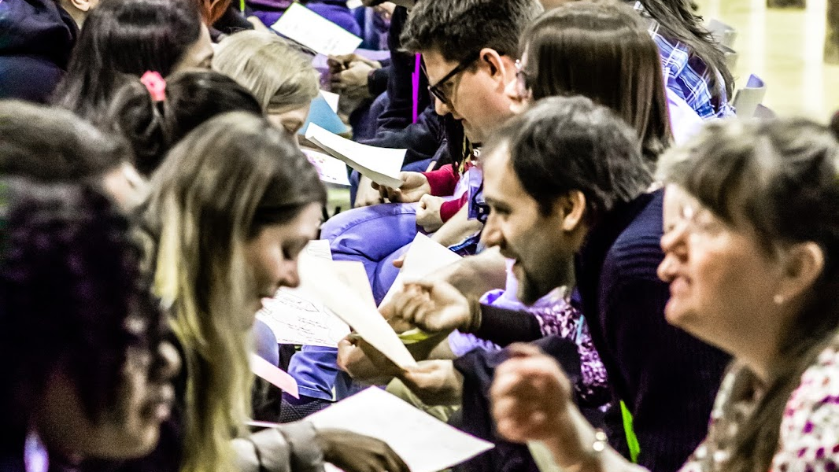
Speed Meet

Slide 39
Speed Meet
Rotate every 5 minutes
(to your left)

Slide 40
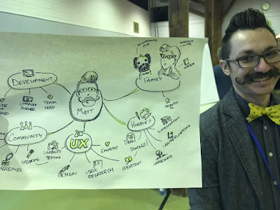
Mindmaps

Slide 41
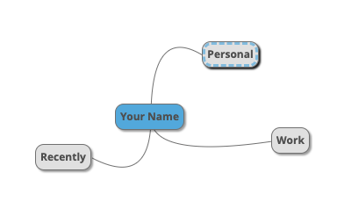
I tend to chat to strangers
For example, when in line at a supermarket or bank or a speed meet.

Slide 42
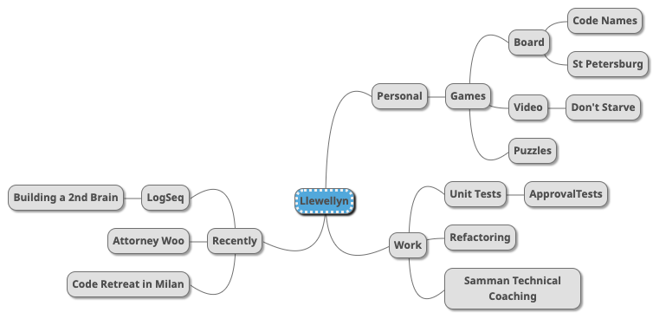
I tend to chat to strangers
For example, when in line at a supermarket or bank or a speed meet.

Slide 43
https://github.com/isidore/Talks/blob/master/Conferences.md

Slide 44
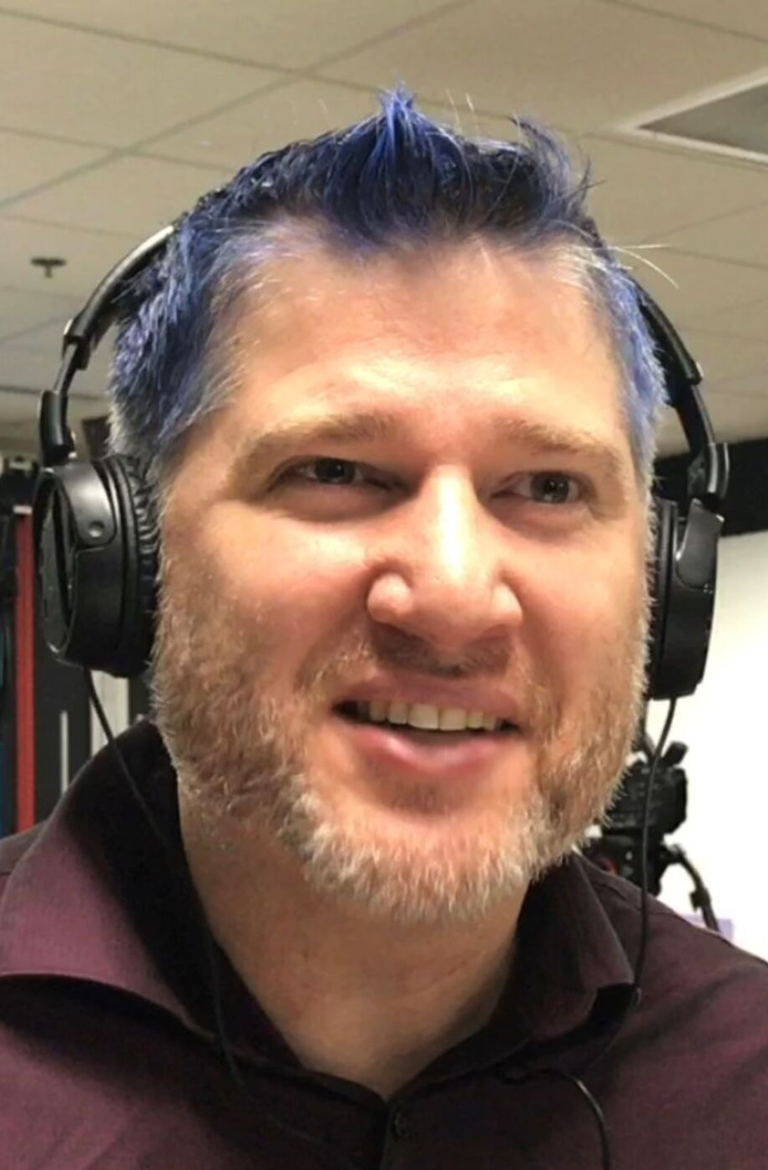
Thank You!
Please connect on LinkedIn and Twitter
Templates from SlidesCarnival
Most Images generated by Dall-E-2 Ai

Slide 45
Unsurprisingly, the team did not achieve 10x productivity. In fact, we found our productivity to be almost the same as it was before…Your mileage may vary, but as far as we’re concerned it’s a resounding NO.
My Experience With Mob Programming
Is the product higher quality? Is there better test coverage? Is the code idiomatic and does it follow best practices? Are the chances of a bug crawling into the product minimized? From our experience this is the most emphatic YES of all the concerns listed above. Not only does having everyone together increase accountability and awareness, but mistakes that may be made by more junior developers are more likely to be caught. Furthermore, when our QA engineer was in the mob, he gained a much better sense of how to go about testing the feature as thoroughly as possible.
http://engineering.appfolio.com/appfolio-engineering/2014/03/17/my-experience-with-mob-programming

Slide 46
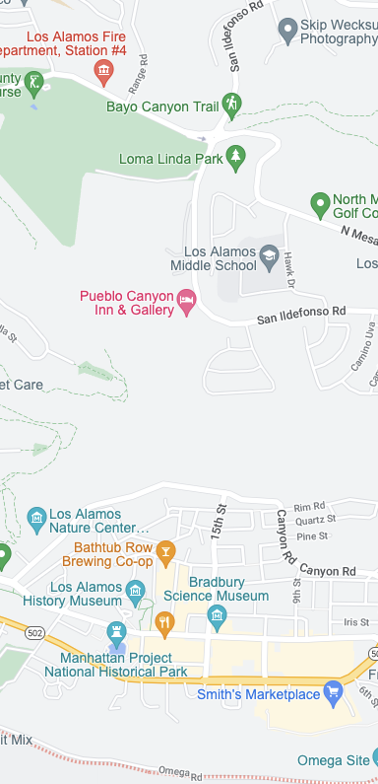
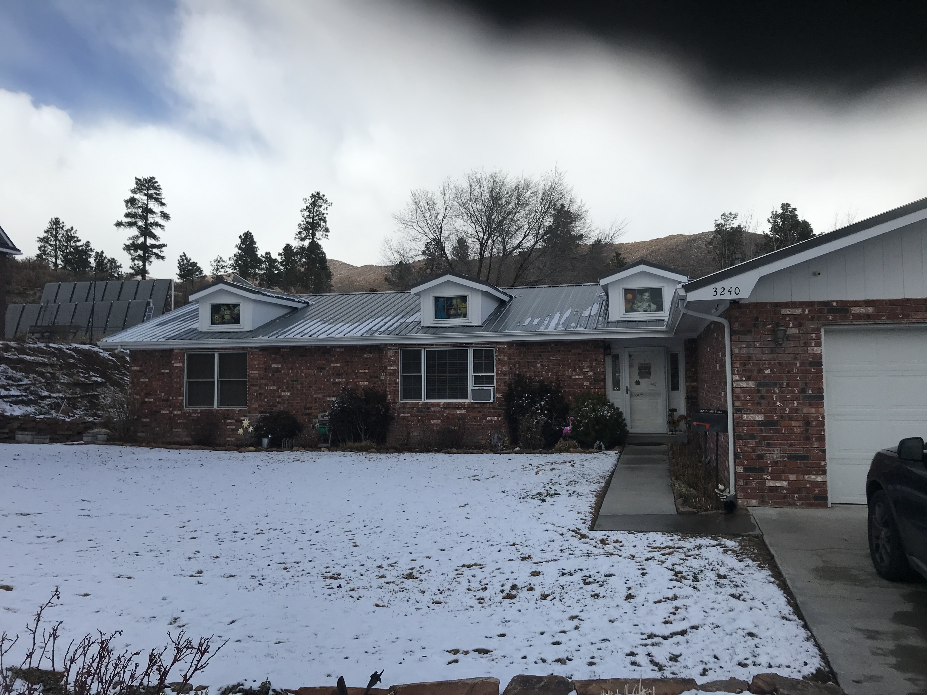
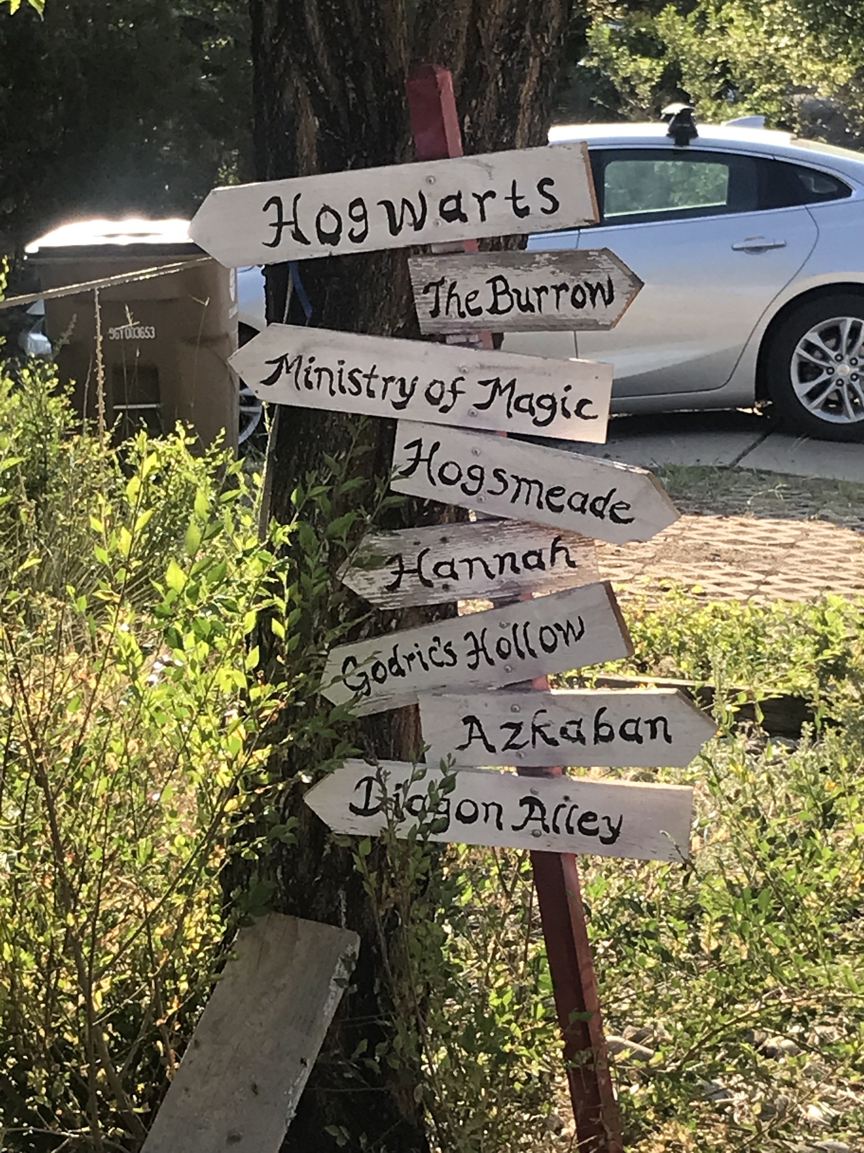
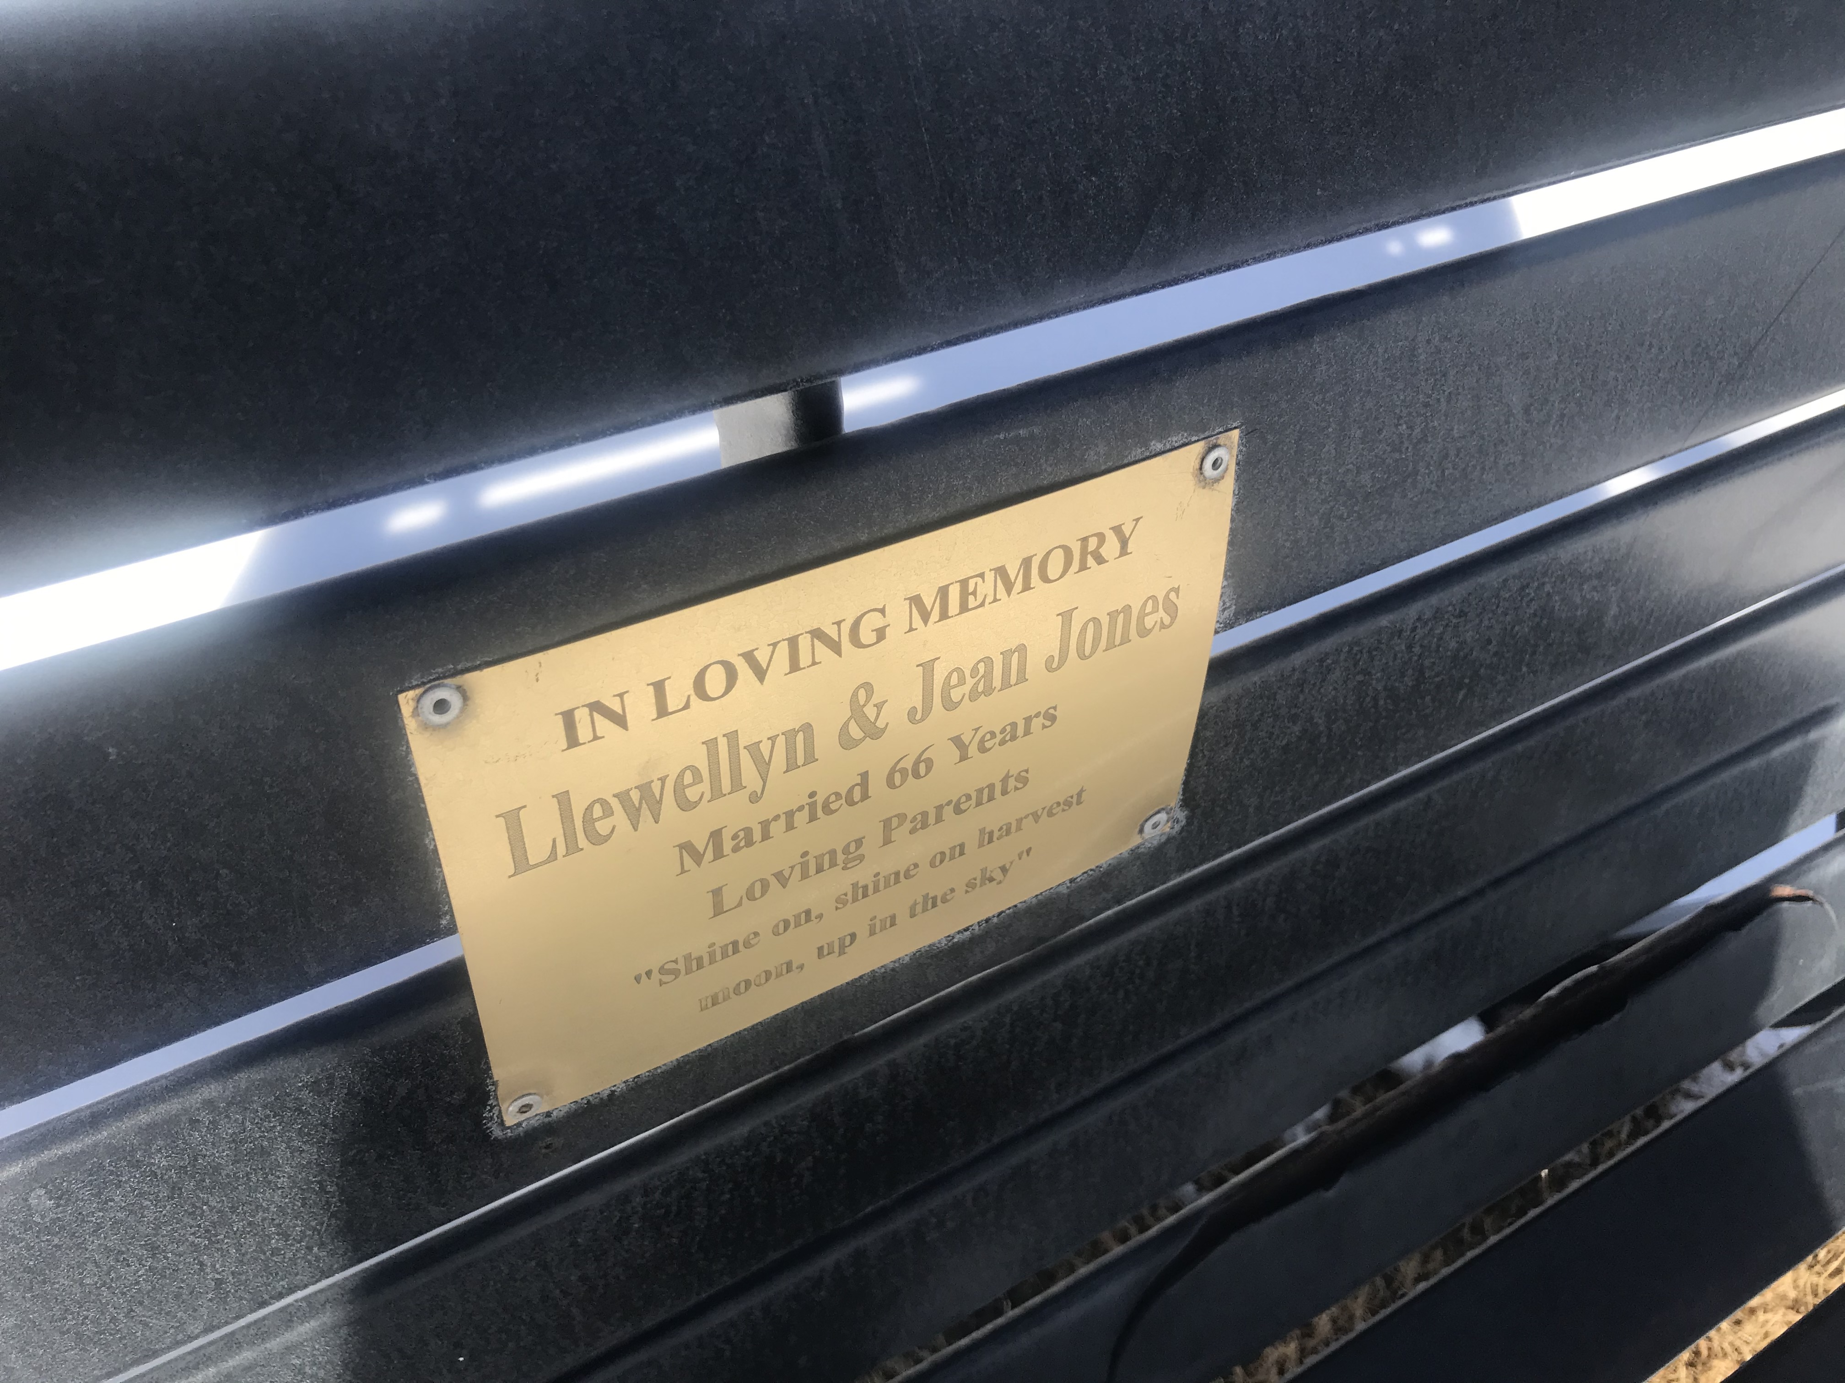
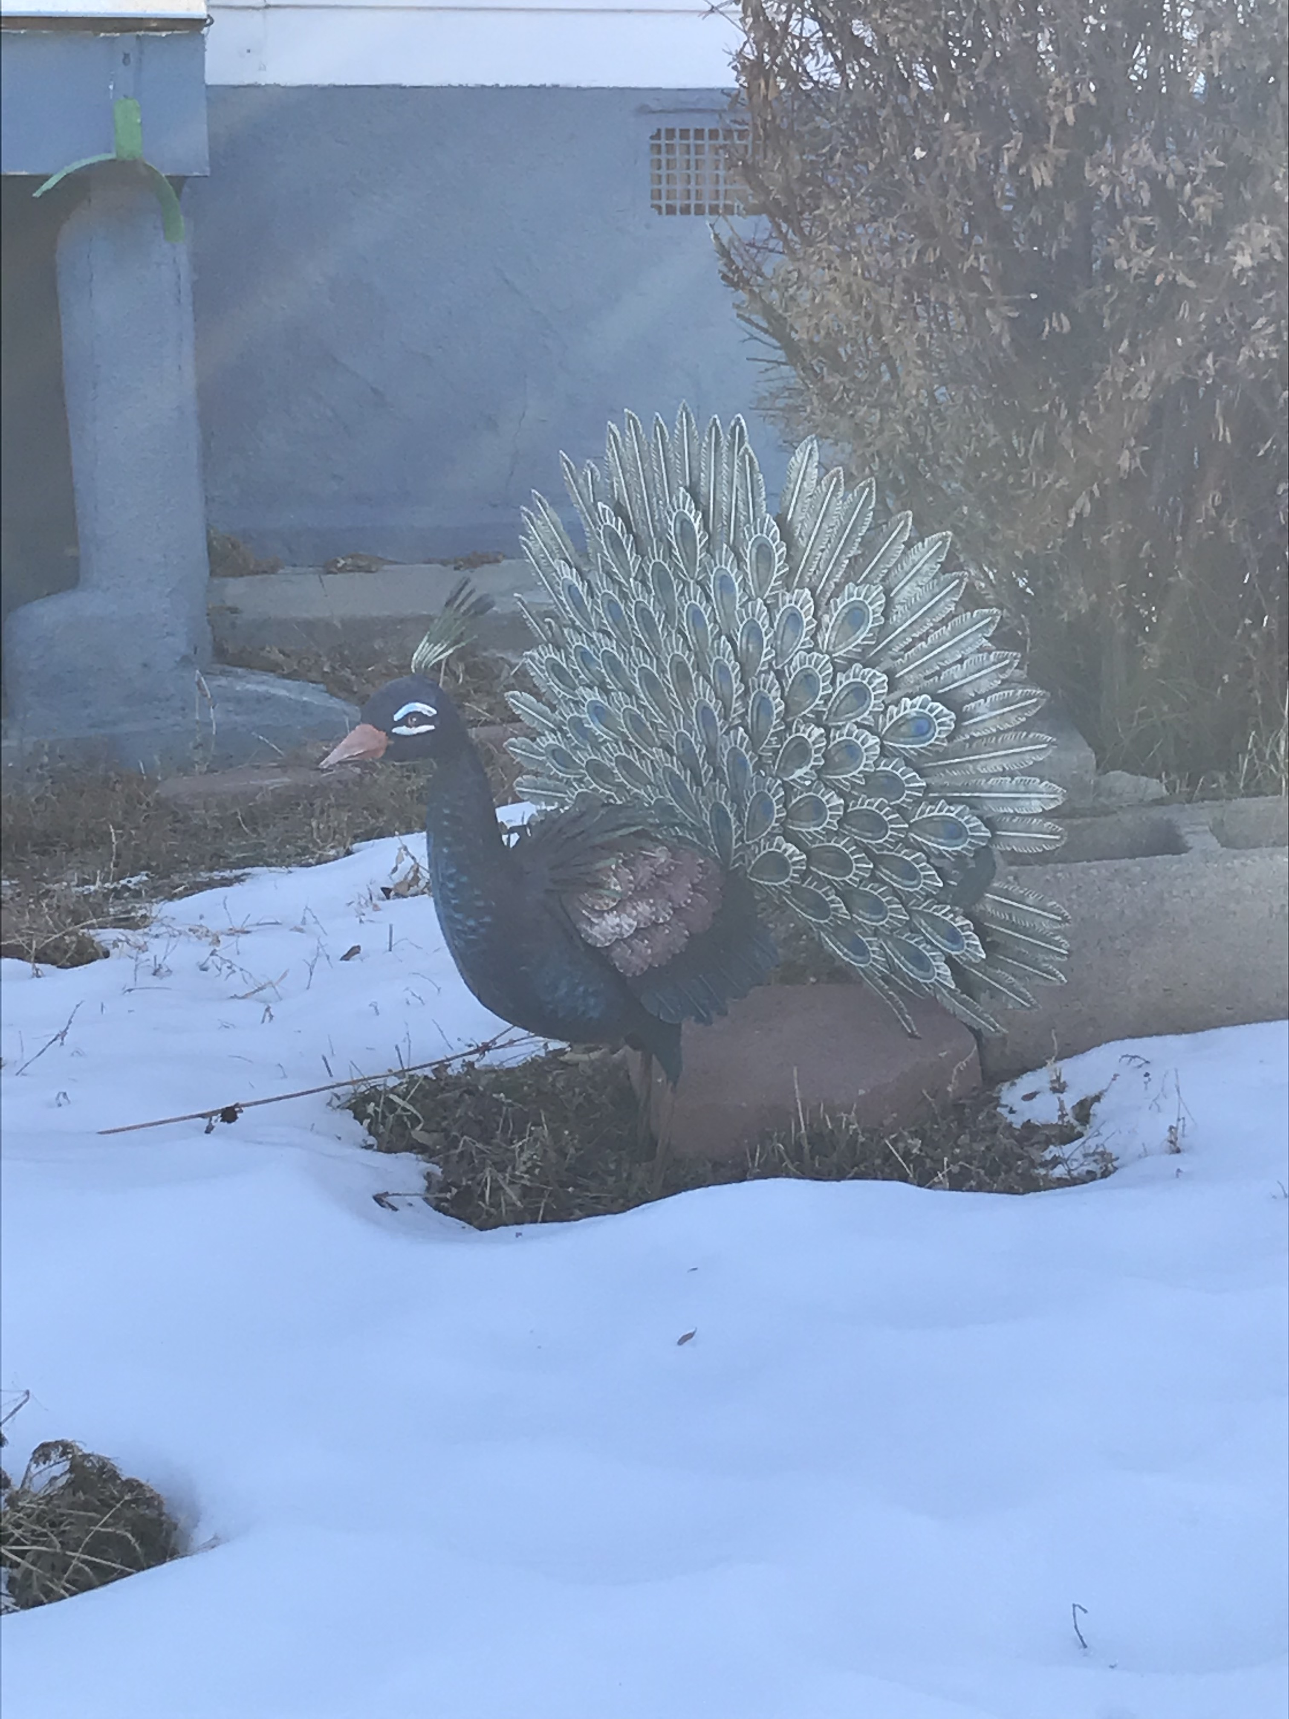

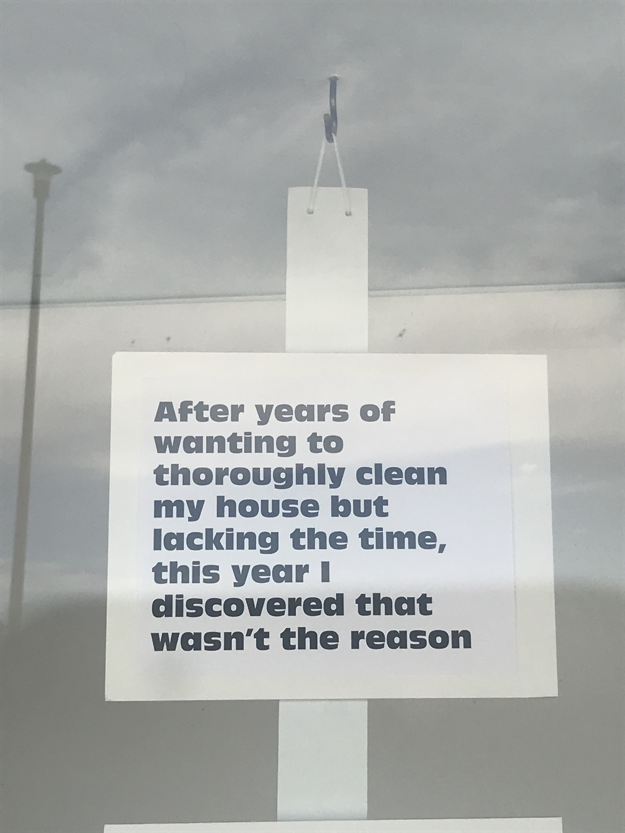
Lucky Principle 1 of 4 :
Opportunity

Slide 47
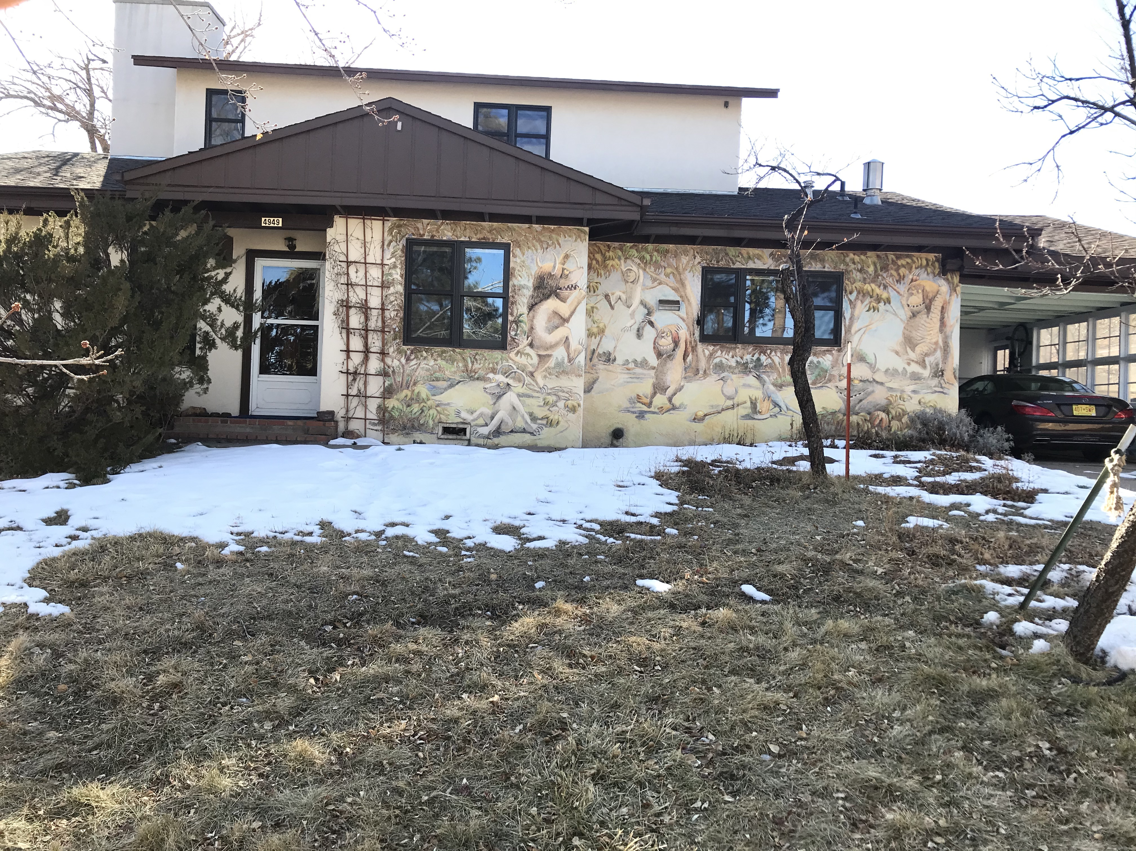
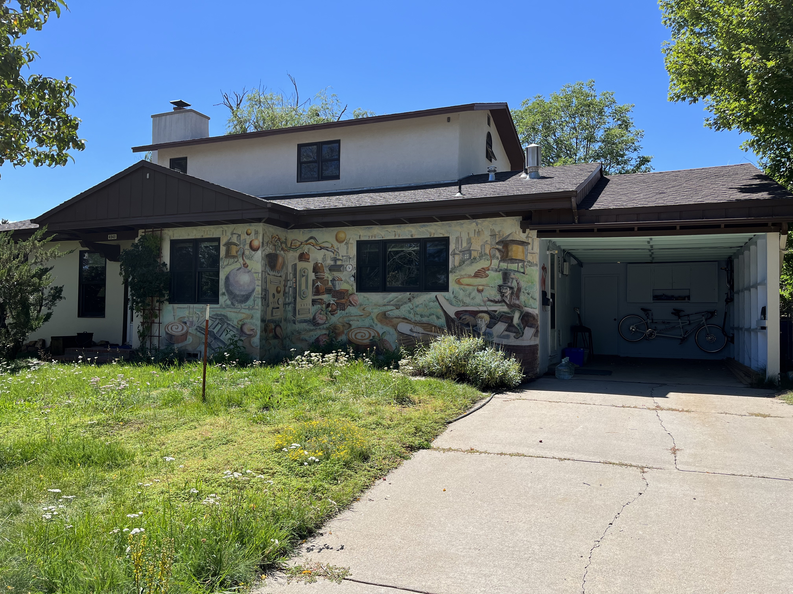
Lucky Principle 1 of 4 :
Opportunity

Slide 48
Lucky Principle 1 of 4 :
Opportunity

Slide 49

PRETITLE
TITLE
Paragraph 1 Present with ease and wow any audience with Canva Presentations. Choose from over a thousand professionally-made templates to fit any objective or topic. Make it your own by customizing it with text and photos.
SUBTITLE
HEADING 1
HEADING 2
Paragraph 2 Present with ease and wow any audience with Canva Presentations. Choose from over a thousand professionally-made templates to fit any objective or topic. Make it your own by customizing it with text and photos.
HEADING 3
HEADING 4
HEADING 5
HEADING 6
FOOTER

Slide 50
PRETITLE
TITLE
Paragraph 1 Present with ease and wow any audience with Canva Presentations. Choose from over a thousand professionally-made templates to fit any objective or topic. Make it your own by customizing it with text and photos.
SUBTITLE
HEADING 1
HEADING 2
Paragraph 2 Present with ease and wow any audience with Canva Presentations. Choose from over a thousand professionally-made templates to fit any objective or topic. Make it your own by customizing it with text and photos.
HEADING 3
HEADING 4
HEADING 5
HEADING 6
FOOTER

Slide 51

HOW TO USE
THIS PRESENTATION
Click on the "Google Slides" button below this presentation preview.
Click on "Make a copy."
Start editing your presentation.
You need to sign in to your Google account.
Click on the "PowerPoint" button below this presentation preview.
Start editing your presentation.
Download and install the fonts used in this presentation as listed on the next page.
Click on the "Canva" button under this presentation preview.
Start editing your presentation.
You need to sign in to your Canva account.
CANVA
GOOGLE SLIDES
POWERPOINT

Slide 52

Write an agenda here.
ADD AN
AGENDA PAGE
Write an agenda here.
Write an agenda here.
Write an agenda here.
Write an agenda here.

Slide 53

WRITE YOUR TOPIC OR IDEA
ADD A MAIN POINT
ADD A MAIN POINT
ADD A MAIN POINT
Briefly elaborate on what you want to discuss.
Briefly elaborate on what you want to discuss.
Briefly elaborate on what you want to discuss.

Slide 54


I'm Rain, and I'll be sharing with you my beautiful ideas. Follow me at @reallygreatsite to learn more.
HELLO THERE!

Slide 55

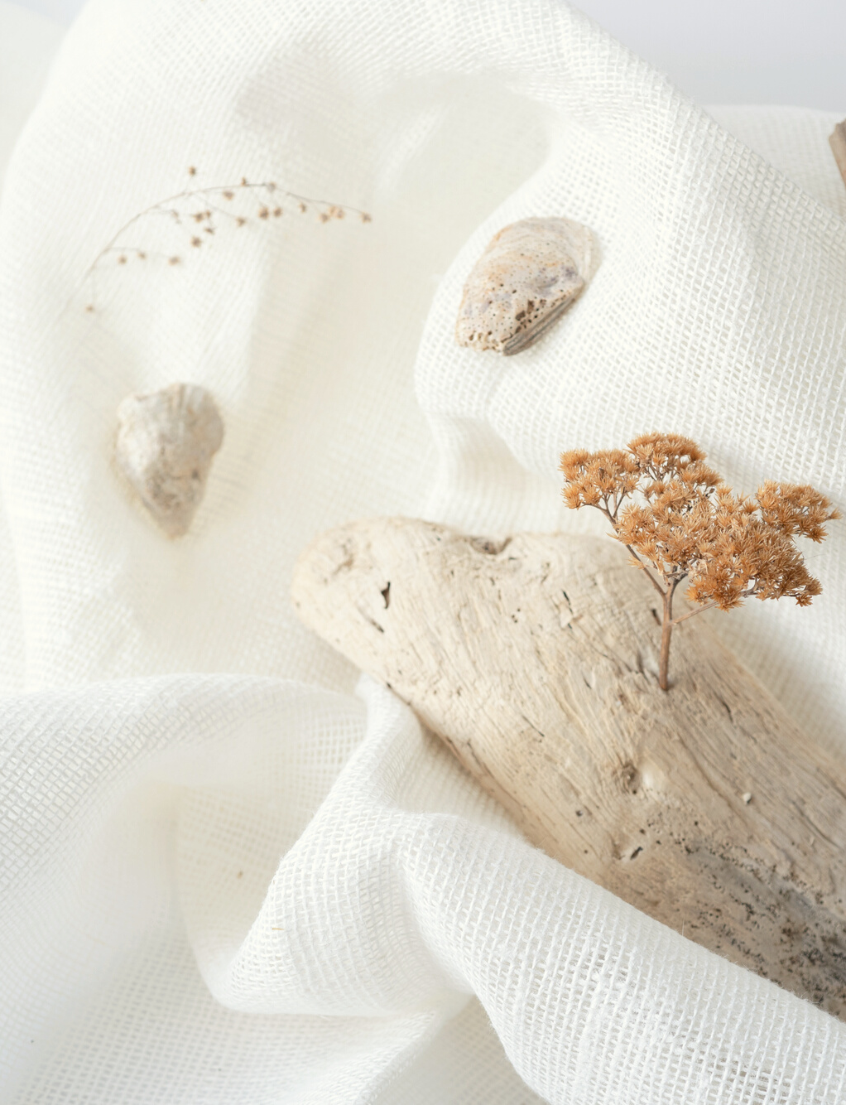
WRITE YOUR TOPIC OR IDEA
Elaborate on what you want to discuss.

Slide 56

WRITE YOUR TOPIC OR IDEA
ADD A MAIN POINT
ADD A MAIN POINT
Elaborate on what you want to discuss.
ADD A MAIN POINT
Elaborate on what you want to discuss.
Elaborate on what you want to discuss.

Slide 57
WRITE YOUR
TOPIC OR IDEA
ADD A MAIN POINT
ADD A MAIN POINT
ADD A MAIN POINT
Elaborate on what you want to discuss.
Elaborate on what you want to discuss.
Elaborate on what you want to discuss.

Slide 58

WRITE YOUR TOPIC OR IDEA
Add a main point Elaborate on what you want to discuss. | Add a main point Elaborate on what you want to discuss. | Add a main point Elaborate on what you want to discuss. .
Add a main point Elaborate on what you want to discuss. | Add a main point Elaborate on what you want to discuss. | Add a main point Elaborate on what you want to discuss.

Slide 59
Write a Heading Here

Slide 60



Write a caption for the photos.

Slide 61


Write an original statement or inspiring quote
— Include a credit, citation, or supporting message

Slide 62




ADD A TEAM MEMBERS PAGE
Elaborate on what you want to discuss.
NAME
NAME
NAME
NAME
Title or Position
Title or Position
Title or Position
Title or Position

Slide 63


ADD A SECTION HEADER

Slide 64

WRITE YOUR BIG TOPIC OR IDEA
Elaborate on what you want to discuss.

Slide 65

WRITE YOUR
TOPIC OR IDEA

Slide 66


123,456,789
Elaborate on the featured statistic.

Slide 67

2 out of 5
Elaborate on the featured statistic.
95%
Elaborate on the featured statistic.
12 million
Elaborate on the featured statistic.

Slide 68
THANK YOU!
Write a closing statement or call-to-action here.

Slide 69

CREDITS
This presentation template is free for everyone to use thanks to the following:
SlidesCarnival for the presentation template
Pexels for the photos
Happy designing!

Slide 70

FONTS IN THIS PRESENTATION
This presentation template uses the following free fonts:
Titles: Montserrat
Headers: Cabin Regular
Body Copy: Cabin Regular
You can find these fonts online too.
Happy designing!

Slide 71

ADD A TIMELINE PAGE
Add a main point
Add a main point
Add a main point
Add a main point
Elaborate on what you want to discuss.
Elaborate on what you want to discuss.
Elaborate on what you want to discuss.
Elaborate on what you want to discuss.

Slide 72
S
What are you doing well?
What sets you apart?
What are your good qualities?
STRENGTHS
Where do you need to improve?
Are resources adequate?
What do others do better than you?
W
WEAKNESSES
O
What are your goals?
Are demands shifting?
How can it be improved?
OPPORTUNITIES
What are the blockers you're facing?
What are factors outside of your control?
T
THREATS

Slide 73
25
20
WRITE YOUR TOPIC OR IDEA
15
10
Elaborate on what you want to discuss.
5
0
Item 1
Item 2
Item 3
Item 4
Item 5

Slide 74

ADD A CHART PAGE
Name
Job Title
Name
Job Title
Name
Job Title
Name
Job Title
Name
Job Title
Name
Job Title
Name
Job Title

Slide 75

RESOURCE
PAGE
Use these design resources in your Canva Presentation. Happy designing!
Don't forget to delete this page before presenting.

Slide 76




































RESOURCE
PAGE
Use these design resources in your Canva Presentation. Happy designing!
Don't forget to delete this page before presenting.

Slide 77

FREE TEMPLATES FOR ALL YOUR PRESENTATION NEEDS
For PowerPoint, Google Slides, and Canva
100% free for personal or commercial use
Ready to use, professional, and customizable
Blow your audience away with attractive visuals

